Slide 2
Business Justification Summary
Bottom Line Mission impact of recommended projects (e.g., benefits) What happens if no projects are selected (consequence of no action)? | Risks Summarize the risk drivers
Projects List the execution plans generated to fulfill projects, their associated solutions, and risks | Leadership Actions State actions needed by leadership Timeline for decisions/funding or future actions necessary for decisions Approval of cost (if applicable)

Slide 3
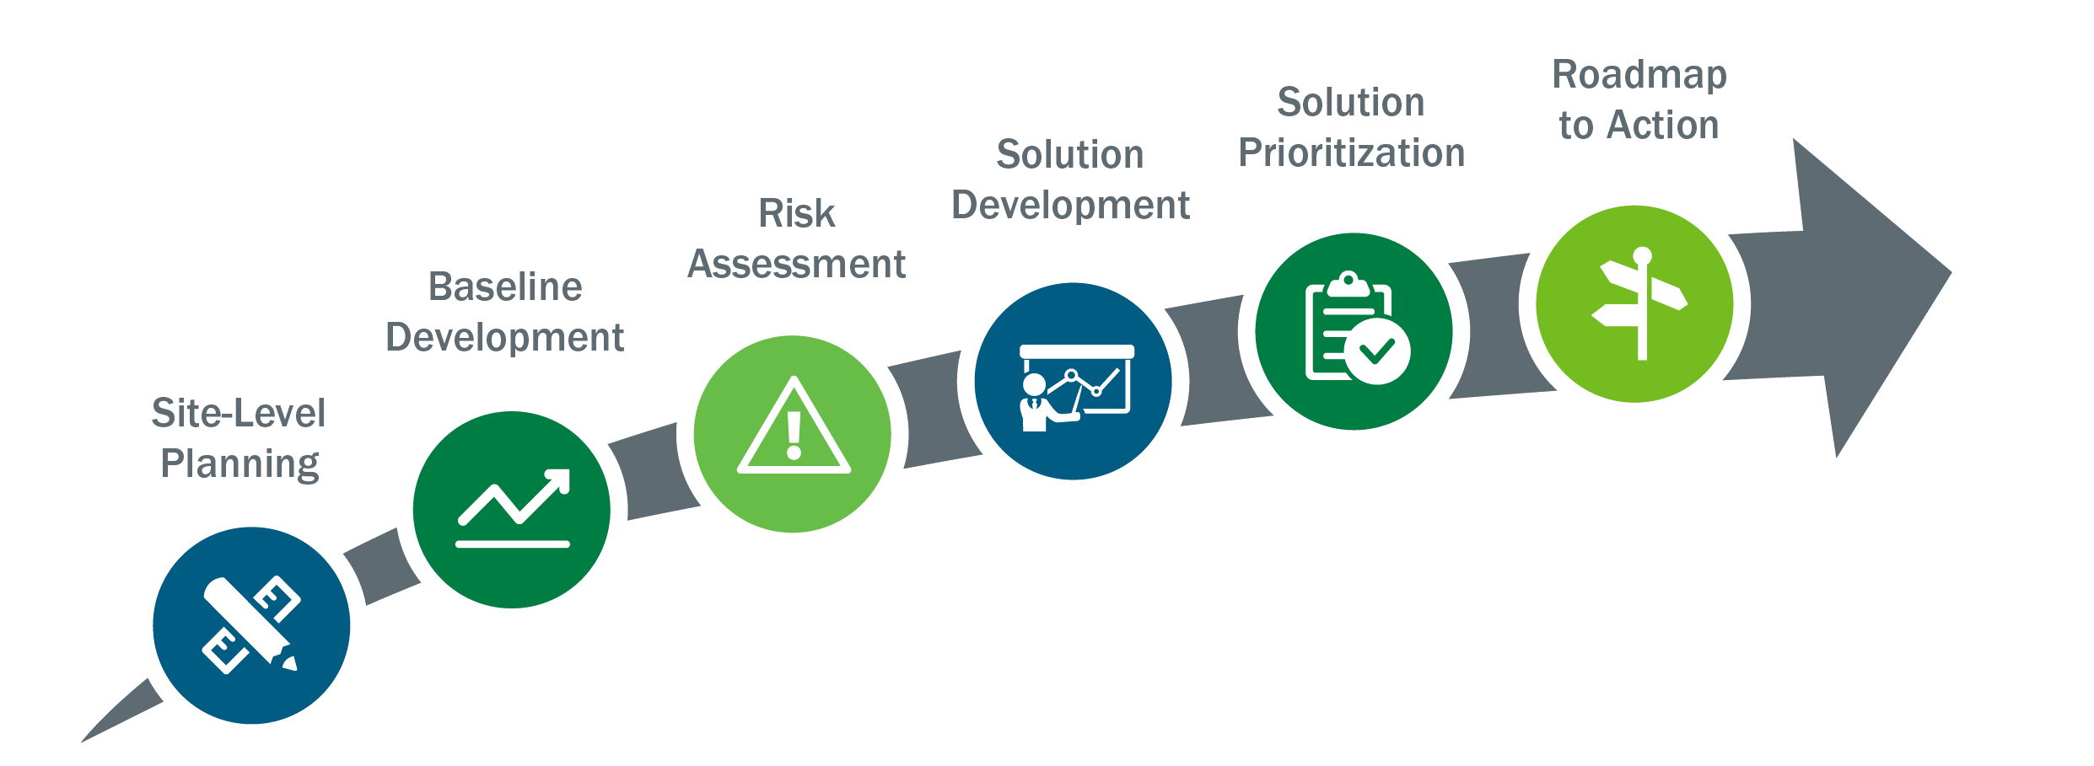
U.S. Department of Energy Federal Energy Management Program’s Technical Resilience Navigator
The Technical Resilience Navigator (TRN) helps users assess risk to a site’s critical functions from energy and water utility disruptions and prioritize solutions that reduce risk.
Key Outcomes
Identify site hazards and vulnerabilities in energy and water systems, operations and plans
Establish relative risk from different sources and how solutions reduce risk
Better integrate planning for energy and water management, continuity of operations, and other site priorities.
Notes:
[Use these slides in presentations to management to describe the overall process and outcomes of resilience planning, including justification for proposed projects]

Slide 4
Resilience Planning Overview
Drivers for the resilience planning process
[Driver]
[Driver]
[Driver]
Site-level planning
[Scope]
[Boundaries]
[Resilience priorities]
[Resilience planning team]
[Stakeholders engaged]

Slide 5
Risk Assessment Overview
Risk Drivers
[Risk factors contribute significantly to the site’s risk.]
[Risk drivers from the Risk Assessment Summary]
[Risk drivers from the Risk Assessment Summary]
[Risk drivers from the Risk Assessment Summary]
[Risk drivers from the Risk Assessment Summary]
[Risk drivers from the Risk Assessment Summary]
[Risk drivers from the Risk Assessment Summary]
[Risk drivers from the Risk Assessment Summary]
Other considerations
[Other considerations could include gaps that may have a lower contribution to the site’s overall risk, but if addressed would enhance the resilience priorities identified in the beginning of the TRN process—see Solution Development Action 1.]
[Other consideration]
[Other consideration]
[Other consideration]
[Other consideration]

Slide 6
Solution Prioritization Criteria and Costs
[Reference Solution Prioritization Actions 3 and 4]
Criteria and Costs
Criteria # | Criteria | Criteria weights
1 | Risk-reduction efficacy
2
3
4
5
6
 | Total | 1
Dollar value breakpoints for 10-year total cost categories | Estimated 10-year total cost | Cost category
 | > $500K | High
 | > $250K to $500K | Moderate
 | $100K to $250K | Low
 | < $100K | Minimal

Slide 7
Prioritized Solutions
[Reference Solution Prioritization Action 4 Summary]
S# | Solution | Estimated 10-year total cost | Cost category | Solution benefit potential | Desired sort order | Desired sort order and 10-year total cost | Carry forward to Roadmap to Action

Slide 8
Roadmap to Action Projects to Execute Solutions
[Reference Roadmap to Action, Action 2 Summary]
Project | P# | S# | Solution | Total estimated project cost | Project location | Funding source | Bundle

Slide 9
Funding Sources Evaluated (Example)
 | Project 1 | Project 2 | Project 3 | Project 4 | Project 5 | Notes
Appropriations
ESPC
PPA
UESC
Grant Funding
Utility Privatization
Energy as a Service
EUL
Notes
Not Feasible
Feasible
Instructions for user: highlight or star the chosen funding source and add the ‘why’ in the notes box

Slide 10
Customer Damage Function Analysis

Slide 11
Next Steps
Next Steps
[Next Step]
[Next Step]
[Next Step]
[Next Step]
Leadership Actions
[State actions needed by leadership]
[Timeline for decisions/funding or future actions necessary for decisions]
[Approval of cost (if applicable)]

